Slide 1
WDV 101Intro to Website Development
Tutorial #9 – Creating Forms

Slide 2
Tutorial #8 Review – Tables
<table><caption> <tr> <th> <td>
Borders (table, gridlines), Border-collapse: collapse;
empty-cells: show; and &nbsp;
rowspan, colspan
Alternating rows (.stripe)
tr:hover
<colgroup> <col />
Tables in Dreamweaver

Slide 3
Forms
Form – a collection of HTML elements used to gather data
User enters data and submit button is pressed and data is sent to a Form Handler. This could be a script or could be sent to a database.
The <form> element is the container for all elements of the form
Use HTML code to create the Form Controls
  <fieldset></fieldset>

Slide 4
Creating a Form
Use the following code
<form id=“idvalue” method= “methodtype” action =“script_url”>
<!-– Inputs -->
</form>
<form id=“form1” method= “post” action =“tutorial9_form_handler.php”>
<!-– Inputs -->
</form>

Slide 5
Adding Inputs
Inputs (<input>) are the fields or elements that the form uses to enter data
For example:
< input type=“texttype” name=“name” id=“id” value=“initialvalue” size=“sizevalue” maxlength=“maxvalue />
Text type can be text, password, email, or another valid value
Size is the width and maxlength is the max number of characters that can be entered

Slide 6
Adding Inputs
For example (continued):
< input type=“texttype” name=“name” id=“id” value=“initialvalue” size=“sizevalue” maxlength=“maxvalue />
Input uses both name and id attributes. It is best practice use both and make them the same name.
If they are tied to a database they should have the same name as the database field
Also remember case sensitivity

Slide 7
Fieldset and Legend
To organize the form elements can use <fieldset> and <ledgend> elements
<fieldset> <legend> legendtext </legend>
<!-- form elements -->
</fieldset>

Slide 8
First Form
<form id=“form1” method=“post” action =“tutorial9_form_handler.php”>
<fieldset> <legend> My Form </legend>
<input type="text" name="FirstName" id="FirstName" value="" size="32" maxlength="32" />
</fieldset>
</form>

Slide 9
Input Types
The label element <label> is used as a prompt to determine the type of data a control collects
Uses for attribute which ties the label to a field based on the id
Usually placed before or after the field to put the prompt
<label for=“FirstName”> Enter your First Name </label>

Slide 10
Adding Password Field
Password fields have the text displayed as stars or bullets to hide the text being entered
Change the type to password
For example:
<label for=“password”> Enter your Password </label>
<input type="password" name="password“ id="password" />

Slide 11
Adding an Email field
Another type for an input field is email
This has simple email validation added in it
For example:
<label for=“email”> Enter your email </label>
<input type="email" name="email" id="email" size="45" />

Slide 12
CSS
Add display block in CSS to stack up fields
input {
display: block;
}

Slide 13
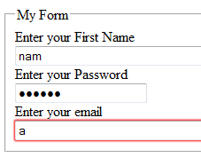
Lab
Create a form with a 3 inputs and 3 labels
  Name (type=“texttype”)
  Password (type=“password”)
  Email (type=“email”)
Create a fieldset to hold all your form elements and give the fieldset a legend of “My First Form”
Add an embedded CSS for input to set the display:block

Slide 14
CSS to style Form Controls
We talked about display block
All of the CSS we have talked about will work with the form elements
fieldset {
display: block;
background-color: #befca7;
}
legend{
color: red;
font-size: 1.9em;
}
input {
display: block;
}
label {
float: left;
padding-right: 15px;
text-align:right;
}

Slide 15
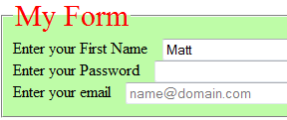
Initial Values and Place Holders
Set the value attribute to give an initial value
<input … value=“value” />
Placeholder attribute was added with HTML5
  Not all browsers support it so make sure it’s not critical to user understanding
<input … placeholder=“placehoder text” />

Slide 16
Radio Buttons
Radio Buttons give multiple options but only one choice is allowed to be picked
Input type=“radio”
Use name attribute to type buttons into the same group
  The name must be identical for all in the same group otherwise both buttons could be pressed
Set the value attribute to give the selection a value

Slide 17
Radio Buttons
<fieldset> <legend> Color Choice </legend>
<label for=“red”> Red </label>
<input type="radio" name="color" id="red" value="red" />
<label for=“blue”> Blue </label>
<input type="radio" name="color" id="blue" value="blue"/>
</fieldset>

Slide 18
Check Boxes
Similar to radio buttons but multiple boxes within a group can be selected
Input type=“checkbox”
Again use the name attribute to tie multiple check boxes to the same group
ID will be the unique id for that box and value will have the value when checked
Checked = “checked” will default it to checked

Slide 19
Check Boxes
<fieldset> <legend> I like the following </legend>
<label for=“pups”> Puppies </label>
<input type="checkbox" name="likes" id="pups" value="puppies" checked="checked"/>
<label for=“cats”> Kittens </label>
<input type="checkbox" name="likes" id="cats" value="kittens"/>
</fieldset>

Slide 20
Selection Lists
Drop-down list boxes displays one option and allows others to be picked from a list
This is done with the select element <select>
Each select has the option <option > elements to give the values in the list
Selected attribute on the option element set to “selected” will set the default value
The multiple attribute on the select element allows multiple values to be selected by ctrl or shift clicking

Slide 21
Selection Lists
<label for="sel"> Animals </label>
<select name="sel" id="sel" size="1" >
<option value="sel_cats">Kittens</option>
<option value="sel_dogs">Puppies</option>
<option value="sel_horse" selected="selected">Horses</option>
</select>

Slide 22
Selection Lists
The size attribute is set to show how many items in the list are displayed
Set to 1 for a drop down style list
Set to a bigger amount for a different style

Slide 23
Selection Lists
<select name="sel2" id="sel2" size="10" multiple="multiple">
<option value="sel2_cats">Kittens</option>
<option value="sel2_dogs">Puppies</option>
<option value="sel2_horse" selected="selected">Horses</option>
</select>

Slide 24
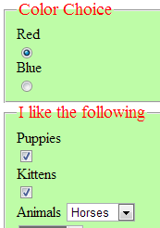
Lab
Create a new field set with a radio button group with at least 3 options
Create a checkbox group with at least 3 options
Create a select list with at least 3 options
Don’t worry as much about formatting at this time

Slide 25
Text Area
The textarea element <textarea> is similar to texttype but allows multiple row entry
The rows and cols attributes give the text area it’s shape
Nice for comment and email boxes

Slide 26
Text Area
<fieldset> <legend> Questions/Comments </legend>
<label for="comments">Message </label>
<textarea name="comments" id="comments" rows="10" cols="50">
</textarea>
</fieldset>

Slide 27
Submitting data
A command button is a form control that lets the use execute an action
Two types
  Submit – submits the entered data to be processed
  Reset – clears the entered data
Value attribute sets the button text
<input type=“submit” value=“send” />
<input type=“reset” value=“clear” />

Slide 28
Lab
Get tutorial9_form_handler.php from the CLASS_INFO/Labs folder
Add a submit and clear button to your form
Set the form attributes to the following:
<form id="form1" method="post" action="tutorial9_form_handler.php">
Upload your files to your lab directory
Test clear and submit buttons

Slide 29
Forms in Dreamweaver
Dreamweaver makes it easy to set up form elements
Demo

Slide 30
Other Topics - iframes
Iframes - An inline frame is used to embed another document within the current HTML document.
Example:
<iframe class="dmacc" src="http://www.dmacc.edu"></iframe>
Can style like other elements
iframe.dmacc {
height: 500px;
width: 800px;
border: solid thick red;
}

Slide 31
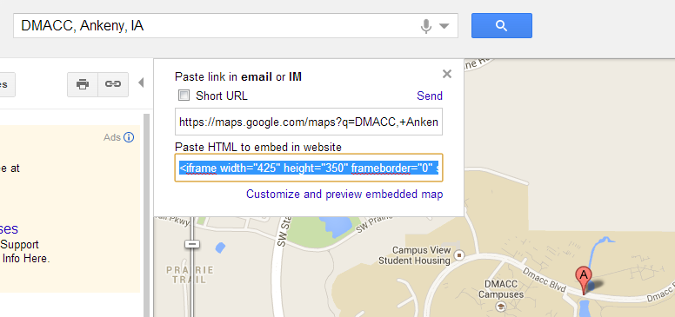
Other Topics - iframes
Some sites have really nice iframes for you to use
Google Maps has a great one (demo)

