Slide 1
WDV 101 Intro to Website Development
Tutorial #8 – Creating Data Tables

Slide 2
Tutorial #6 Review – Layouts
Two Column Fixed Width, Three Column Fixed Width
<header> <footer> <nav> <aside> <section id=“main”>
Class VS. ID
Container
Universal Selector (*)
Box-Shadow and Box-Radius
Figure Element (<figure> and <figcaption>)
Layouts in Dreamweaver

Slide 3
Tutorial #7 Review – Layouts
Liquid layouts use % instead of a fixed width __px;
Min-width, Max-width
Print Styles
Media Attribute
<link rel=“stylesheet media=“screen” />
<link rel=“stylesheet media=“print” />
@page
Display Property (display:none;)
Display VS Visibility

Slide 4
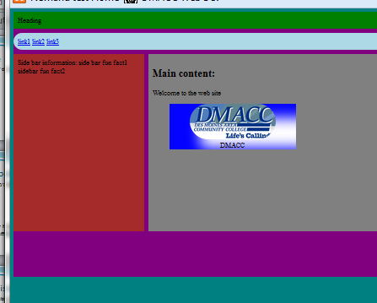
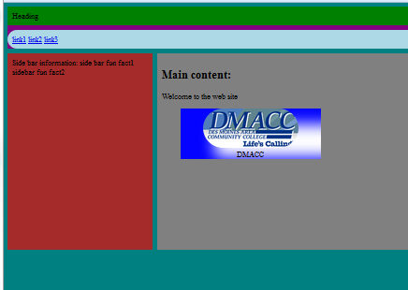
Display vs. Visibility
Left is display:none, right is Visibility: hidden
In this case clearing the footer removed the clear:both

Slide 5
Creating tables
The <table> element used to create the table
The title attribute used to describe table content
  Displays on mouse hover
The <caption> element used to create a visible caption for the table
<table title = “tabletitle”>
<caption> Caption </caption>
</table>

Slide 6
Creating Rows and Cells
The table row <tr> element is used to create a row
Good practice to end the tr right after starting it
Use space to make it easier to read.
Must create a tr for each row in the table. If your table is 4x4 (4 rows 4 columns) you would need 4 TRs
<tr>
row data goes here
</tr>

Slide 7
Creating Rows and Cells
The table data <td> element is used to create a table cell
Goes between the table row element
Need a td for each cell
<table>
<tr>
<td> cell1</td>
<td> cell2</td>
</tr>

Slide 8
Table Headers
Use table header <th> element to format differently from a cell.
In most cases the table header centers text and makes it bold
<tr>
<th>Heading 1 </th>
<th>Heading 2 </th>
</tr>

Slide 9
Creating Table Borders
Table borders are the horizontal and vertical lines that surround the table
Also known as gridlines
Use the border property to set the border in pixels
In CSS:
  Table – Create the outside edge of the table
  Th, td – Create the gridlines

Slide 10
Table - HTML
<table title=“Example">
<caption> Example</caption>
<tr>
<th>Heading 1 </th>
<th>Heading 2 </th>
</tr>
<tr>
<td>Cell1</td>
<td>Cell2</td>
</tr>
</table>

Slide 11
Table Style - CSS
table {
border: solid 5px black;
}
th, td{
border: solid 3px navy;
}

Slide 12
Displaying Empty cells
Can use the empty-cells property on the td selector to show the empty cell
Without the gridlines will not display
td{
empty-cells: show;
}
Prior to this property you would have to put &nbsp; in the specific cell (or all cells that needed it)

Slide 13
Merging Cells in Columns
Combine adjacent cells using following attributes
  Colspan
  Rowspan
The number of rows or columns to merge as the attribute values.
Should be placed in the cell where it starts
All empty cells should be removed
<td colspan=“value” > </td>
<td rowspan=“value” > </td>

Slide 14
Collapsing Internal Borders
By default each cell has it own border
This can lead to a double edge line
Border-collapse:
  Separate (default) – Creates double rule lines
  Collapse – Gives single line

Slide 15
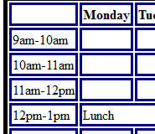

Collapsing Internal Borders
table {
border: solid 5px black;
border-collapse: collapse; /*Seen on right picture*/
}

Slide 16
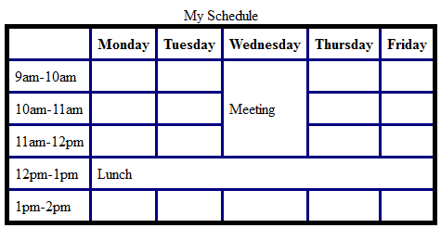
Lab
Create a 6x6 Table
Create the top row as headers with the days of the week
Add a caption
Add Solid 5px Black border to the table and solid 3px navy border to the cells
Add border-collapse: collapse; to the table
Add a rowspan and colspan

Slide 17
Using CSS to Format Tables
Can format the table with many of the CSS properties we have talked about.
Table{
border: solid 5px black;
border-collapse: collapse;
width: 900px; /*fixed width*/
width: 75%; /* Liquid*/
margin: 10px auto;
}

Slide 18
Using CSS to Format Tables
caption {
color: white;
background-color: midnightblue;
font-weight: bold;
font-size: 1.5em;
font-style: italic;
}

Slide 19
Alternating Row Color
Create a class with different styles
Apply that class to every other row
.stripe {
background-color: dodgerblue;
}
<tr class=“stripe”>… </tr>
<tr>… </tr>
<tr class=“stripe”>… </tr>

Slide 20
Creating a Hover Effect
Similar to the hover effect of anchors a hover pseudo class can be used for a table hover effect.
tr:hover{
color:white;
background-color: black;
}

Slide 21
Formatting Table Columns
The column element (<col />) is used to format one or more columns
Entered directly below the caption
Should add a <col /> for each column in the table
Column elements are placed inside the <colgroup> element. A 3 column table with the first two class red
<colgroup>
<col class=“red” span=“2”/>
<col />
</colgroup>

Slide 22
Formatting Table Columns
Table Columns:
  Standards say Only background, border, width, and visibility properties of CSS are available.
  IE allows other formatting properties.
  Other broswers may also.
Order of precedence for table styles:
  Highest - th or td
  Middle - tr
  Lowest - table

Slide 23
Lab
Add a independent class called stripe with a background-color of “dodgerblue”
Add the stripe class to every other row to give a stripe effect
Add style to your caption and table
Add a hover effect
Add a column group style
Add a Column group class so the text in the third column is red.

Slide 24
Tables in Dreamweaver
A lot faster to build and maintain then by hand
Demo

