Slide 1
WDV 101 Intro to Website Development
Tutorial #6 – Creating Fixed Width Layouts

Slide 2
Tutorial #5 Review – Box Model
Every html element is surround by a box
Content, Padding, Border, Margin
Can set individual side, all sides, or combo of shortcuts
Float
Clear
Background-image, background-color, background-position, background-repeat, background-attach, background-cover*
CSS Precedence (1. User defined, 2. Inline, 3. Embedded 4. External, 5. Browser Defaults)
Pathnames Project

Slide 3
Reminders
Final Project Purpose and Organization Due Date coming up
  Due Next Class (10-24-13)
Have Everything done by 10-19-13
  Homework 1-5
  Pathnames Project
  Homework Page
  Exam and Lab retakes
  Anything that needs a regrade (already submitted in blackboard) send me an email to grade.

Slide 4
Page Layouts
Fixed Width – Content stays the same when the window is resized
Liquid – Content adjusts (expands/contracts) when window is resized.
Hybrid – Combo of both
Recall the box model (format and position the elements)
Window resize could be use adjusted or could be changes in resolution

Slide 5
Two Column Fixed Layout
Horizontal header at the top (<header>)
Horizontal navigation bar (<nav>)
Sidebar with links or information (<aside>)
Main Content Area (<section id=“main”>)
Horizontal Footer with contact information or general information (<footer>)
Prior to HTML5 all elements would be divided with div tags and different IDs.

Slide 6
Class VS ID
Classes
  In CSS .class
  In HTML <element class=“classname” >
ID
  In CSS #idname
  In HTML <element ID=“idname” >
The id selector is used for a single element on the page
Only 1 element can have an ID. Multiple elements can be formatted with classes

Slide 7
Two Column Fixed Layout
HTML 5 added elements for header, footer, nav, aside but did not put a “main’ or content. They did add the section element.
We use the section element with and id to format the main content section.
#main{
background-color: gray;
width: 680px;
}
<Section id=“main” >
</section>

Slide 8
Universal Selector
CSS selector to select all elements
Due to styling precedence and browser defaults trying to setup layouts can sometimes not look correct.
  This could be due to margin and padding defaults
Use the Universal Selector (*) to clear out all values.
* {
margin: 0;
padding: 0;
}

Slide 9
Creating the Container
Container serves as a large box to put all the elements in. This is also sometimes called a wrapper.
Advantages
  It can determine the width of the page layout
    Recommended to have a width of 900 to 960 pixels
  It can be used to center the layout horizontally
  A border can be added to unify page content
  Can be used to apply the background (color or image) to contrast the body element
Must account for browser’s frame, scroll bars, etc

Slide 10
Creating the Container
#container {
background-color: purple;
width: 930px;
border-width: 1px;
margin: 0 auto;
}
<body>
<div id="container">
…
</div> <!-- end container -->
</body>
</html>

Slide 11
Determine the Content Width
Since we set the container width to 930px, we need to make sure no other elements have a width greater than that otherwise the layout will break
Take the width of the container, subtract the left/right margins, borders, and padding values from the width. That will give the max width.
header {
background-color: green;
margin: 0 0 10px 0;
padding: 10px;
width: 910px; /* 930 – 10padding left - 10 padding right */
}

Slide 12
Adding a Navigation bar
Use the nav element to define the navigation
Since our goal is a 2 column fixed width layout we can mimic the header for the nav width
nav {
background-color: blue;
width: 910px;
margin: 0 0 10px 0;
padding: 10px;
}

Slide 13
Using the aside Element
HTML5 element aside is used to mark content that is not the main
Can have more than one
  Should use ID to uniquely identify
Use float to position
In our example we have 930px container width. The Width of the aside + main content must be <= 930px

Slide 14
Main Section
This section will hold the main content of the page
Uses <section> element with an ID to identify the main area.
There is not a specific element for main.
Since our goal is to have a side bar and main content we need to remember that the combined width must be less than our container (930px)
Float can be used to position the main section

Slide 15
Main and Aside
aside{
background-color: brown;
width: 200px;
margin: 0 10px 10px 0;
padding: 10px;
float: left;
height: 400px;
}
#main {
background-color: gray;
width: 680px;
margin: 0 0 10px 0;
padding: 10px;
float: right;
height: 400px;
}

Slide 16
Dependent ID
Just like classes, IDs can be independent or dependent on an element
Since IDs can only be used once on the page the dependent ID would be used to specify one element that the ID will be used on
Div#container
{
background-color:teal;
{

Slide 17
Creating Style for the Footer
Uses the <footer> element
In our example the footer is similar to the header for width
footer {
background-color: red;
width: 910px;
padding: 10px;
clear: both;
height: 75px;
}

Slide 18
Creating Three Column Layout
Very similar to what we have done so far with the two column layout
Create a second section or aside area for the 3rd column
Can float left, no float, float right
Could also float all three columns the same direction
  Float right, right, right would be the same effect.
Still must make sure the total width is less than the main container

Slide 19
Quiz – Match Up
.center
div#main
Nav.links
#quotes
  Independent ID
  Independent Class
  Dependent ID
  Dependent Class
Notes:
1-B, 2-C, 3-D, 4-A

Slide 20
The Box-Shadow Property
Box-shadow property used to create a 3Dshadow effect
Box-shadow: h-shadow v-shadow blur spread inset;
H-shadow – Position of the horizontal shadow (Shifts shadow to the right from the right)
V-shadow – position of the vertical shadow (shifts shadow down from the top)
Blur – The blur distance (optional)
Spread – The spread distance (optional)
Inset – Sets shadow placement inside rather than outside (optional)

Slide 21

Box-Shadow
.logo {
box-shadow: 10px 15px 10px;
}
<img src="images/dmacclogo2009.gif" class="logo" />

Slide 22
Creating Rounded Corners
Prior to HTML5 it took 4 images manipulated to create the effect
HTML5 adds the border-radius property which specifies the a radius of measurement
Works with the shadow propery (shadow rounded aswell)
Border-radius for all 4 sides or specify one corner
  Border-top-left-radius
  Border-top-right-radius
  Border-bottom-right-radius
  Border-bottom-left-radius

Slide 23

Creating Rounded Corners
.logo {
box-shadow: 10px 15px 10px;
border-radius: 20px;
}

Slide 24
Figure element
When using image for informational purposes it can be wrapped with the <figure> element
Captions can be added with <figcaption> element
Benefits for styling and screen readers
<figure>
<img src="images/dmacclogo2009.gif" class="logo" />
<figcaption>DMACC</figcaption>
</figure>

Slide 25
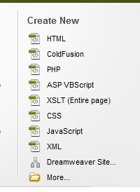
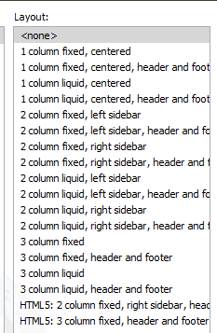
Layouts in Dreamweaver
Page Type: HTML
Lots to choose from
Preview available

Slide 26
Lab
Create the container: Width 930px
Create the header, nav, and footer
  910px width, 10px padding, 10px margin on bottom
  Footer should clear the float
Create the side bar
  float left, 200px wide, padding 10px, margin 10px on right and bottom
Create the main section
  ID main, float right, 680px wide, 10px padding
Add shadow and rounded corners to the DMACC

Slide 27
WDV101 Intro to Website Development
Tutorial #7 – Creating Liquid Width Layouts

Slide 28
Liquid Layouts
Setup the same as fixed except use % instead of pixels
Content adjusts with window resizing
Max width 100% should be less than 100% due to some browser rendering
aside{
width: 20%;
}
#main {
width: 68%;
}
footer {
width: 90%;
}

Slide 29
Tutorial 7 – Liquid Layouts
Page 384 advantages of 2 layouts
Page 396 Floating columns
Min and Max width for to prevent content shifts
  Min-width: value;
  Max-width: value;

Slide 30
Using Print Styles
You can setup a specific CSS to format you page for printing (on a physical printer)
Print Style
  Change text color to black and background to white
  Set font size
  Set font
  Set elements to not be displayed
  Set line height to 120% or greater
  Use @page rule to set the page size and margin

Slide 31
Media Attribute
Using the media attribute
  All (default) – Style for all devices
  Screen – Only style what is displayed in the browser window
  Print – Assigns style to document being printed
<link rel=“stylesheet” href=“style.css” type=“text/css” media=“screen” />
<link rel=“stylesheet” href=“print.css” type=“text/css” media=“print” />

Slide 32
@page Rule
Defines the size of the print area
@page {
Size: 8.5in 11in;
Margin: 0.5in;
}

Slide 33
Display Property
Can use the display property to hide content
Header {
display:none;
}
What CSS Property hides content besides display?
How do they act different?

Slide 34
Display vs Visibility
Visibility - The visibility property specifies whether or not an element is visible.
Keeps spacing. Display does not keep spacing
Footer
{
visibility: hidden;
}

Slide 35
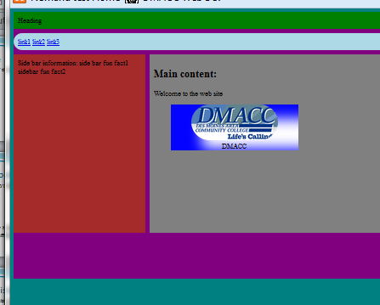
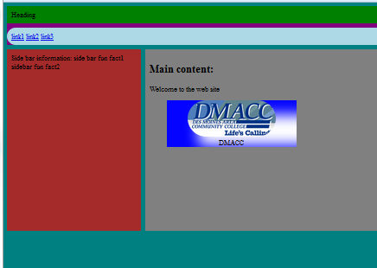
Display vs. Visibility
Left is display:none, right is Visibility: hidden
In this case clearing the footer removed the clear:both

